Slide 1

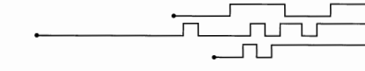
Digital systems
Chapter 1
Number systems
Dr. Iness NEDJI MILAT
iness.nedji@ensia.edu.dz

Slide 2
Digital systems
Digital system is a combination of devices (most often electronic) designed to manipulate information that are represented in digital form (discrete values).
Some of the more familiar digital systems include digital computers,
Information processed by computer can be on different formats : number, text, image, audio, video,
All these formats are represented in numeric values (number systems),
In computer, they are always coded in binary form (BIT: BinarydigIT),
Bits : sequence of 0 and 1.

Slide 3
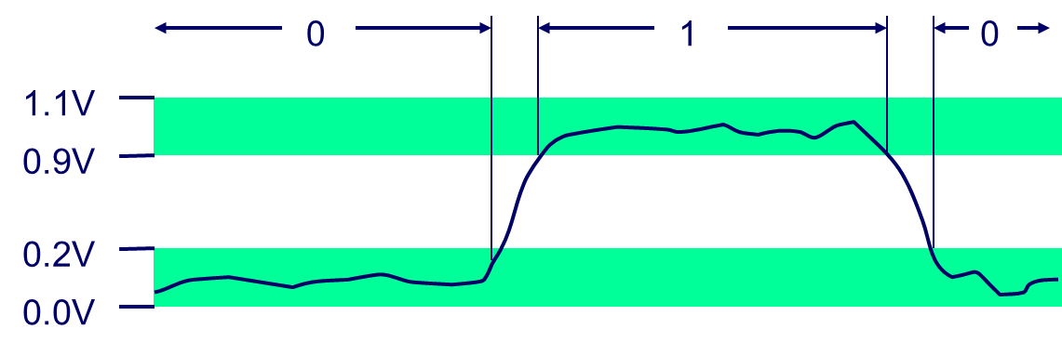
Bits : Binary digITs
Computer systems do not represent numeric values using the decimal system but using binary system.
Computers are built around the idea of two states : true (1) and false (0).
Transistors represent this in hardware,
and bits represent this in software!
Source
Drain
Gate
Gate
Drain
Source
pMOS
nMOS
Bit (Binary digIT) is represented by two voltage levels, where any voltage between 0 and 0.2 V represents a 0 and any voltage between 0,9 and 1,1 Vrepresents a 1.

Slide 4
Number systems
All data in digital systems are represented in number systems,
Many number systems are in use in digital technology. The most common are the decimal, binary, octal, and hexadecimal systems.
The decimal system is clearly the most familiar to us because it is a tool that we use every day.
Unsigned : 0, 1, 2, 3,,,,
Integer
Signed : ,,,,-2, -1, 0, 1, 2,,,,,
Decimal number
Fixed-point : 3.14
real
Floating-point : 3.14 = 31.4 * 10⁻¹ = 0.0314 * 10²

Slide 5
Decimal System : base 10
The decimal system is called the base (radix)10 system because it has 10 digits (0,1,2,3,4,5,6,7,8,9)
The decimal system is a positional-value system in which the value of a digit depends on its position.
MSD
LSD
For example :
2
7
4
5
Positional value
Weights:
10²
10¹
10⁰
10^{x}
10³
Tens
ones
Thousands
hundreds
2745= 2*10³ + 7*10² + 4*10¹ + 5*10⁰ (Polynomial representation)
2745.214 = 2*10³ + 7*10² + 4*10¹ + 5*10⁰ + 2*10⁻¹ + 1*10⁻² + 4*10⁻³
The 2 carries the most weight; it is referred to as the most significant digit (MSD).The 5 carries the least weight and is called the least significant digit (LSD).

Slide 6
Binary system: Base 2
The Binary Number System uses base (radix) 2.
It includes the digits 0 and 1.
For example:
Most significant bit (msb)
Least significant bit (lsb)
1
1
0
1
Positional value
Weights:
2³
2²
2¹
2⁰
2^{x}
twos
fours
ones
eights
(1101)₂ = 1*2³ + 1*2² + 0*2¹ + 1*2⁰ = 8 + 4 + 0 +1 = 13₁₀
(1011.101)₂ = 2³ + 2¹ + 2⁰ + 2⁻¹ + 2⁻³

Slide 7
Number system: generalization
Number X in radix r system :
(x)_{r} = x_{n-1}x_{n-2} ... x₁x₀ . x₋₁ x₋₂ ... x_{-(m-1)} x_{-m}
Decimal Value of X :
Val₁₀ = x_{n–1}× r ^{n–1} + x_{n–2}× r ^{n–2} + … + x₁× r + x₀ + x_{–1} × r^{–1} + x_{–2} × r^{–2} + … + x_{-m} × r^{-m}
Examples:
(11011.01)₂ = 1×2⁴ + 1×2³ + 0×2² + 1×2 + 1 + 0×2⁻¹ + 1×2⁻² = (27.25)₁₀
(2103)₄ = 2×4³ + 1×4² + 0×4 + 3 = (147)₁₀
(156.7)₈ = (1x8² + 5x8¹ + 6x8⁰ + 7x8⁻¹ ⁾₁₀ = (64 + 40 + 6 + 0.875)₁₀ = (110.875)₁₀
(55)₉ = (45 + 5)₁₀ = 50₁₀
(12)₁₂ = (12 + 2)₁₀ = 14₁₀
position
radix

Slide 8
Octal and hexadecimal systems (1)
When working with bits, oftentimes we have strings with 32 or 64 bits (a large number of bits!!).
So, it is more convenient and less error-prone to write the binary numbers in intermediate base systems such as Octal (base 8) or Hexadecimal systems (base 16),
Octal and Hex are often used in a digital system as sort of a “shorthand” way, more compact, to represent strings of bits.
However, it is important to keep in mind that digital circuits all work in binary.
Octal and Hex are simply used as a convenience for the humans involved.
Notes:
Hexadecimal : Coined at IBM in 1963. From Greek hexi (six) and Latin decem (ten).

Slide 9
Octal and hexadecimal systems (2)
Base 8 (octal) numbers : 0,1,2,3,4,5,6,7
one octal digit is formed by grouping 3 bits.
100001010110₂ = 100 001 010 110
= 4 1 2 6 ₈
Base 16 (Hexadecimal) is most useful as a “shorthand” notation for binary numbers.
Hex numbers : 0,1,2,3,4,5,6,7,8,9,A,B,C,D,E,F
one hexadecimal digit is formed by grouping 4 bits and start with 0x
100001010110₂ = 1000 0101 0110
= 8 5 6 ₁₆
= 0x 856

Slide 10
Counting . . . 2, 8, 10, 16
Decimal | Binary | Octal | Hexadecimal
0 | 00000 | 000 | 00
1 | 00001 | 001 | 01
2 | 00010 | 002 | 02
3 | 00011 | 003 | 03
4 | 00100 | 004 | 04
5 | 00101 | 005 | 05
6 | 00110 | 006 | 06
7 | 00111 | 007 | 07
8 | 01000 | 010 | 08
9 | 01001 | 011 | 09
10 | 01010 | 012 | 0A
11 | 01011 | 013 | 0B
12 | 01100 | 014 | 0C
13 | 01101 | 015 | 0D
14 | 01110 | 016 | 0E
15 | 01111 | 017 | 0F
16 | 10000 | 20 | 10

Slide 11
Bytes, Nibbles, Words, MSB, LSB, …
It’s quite tedious to work with only binary numbers…
In a group of bits, the least significant bit (lsb) is to the right. The most significant bit (msb) is to the left.
Within a word, the terms are the most significant byte (MSB) and the least significant byte (LSB).
10100001000001011110101101001101
Word (32-bit word)
msb
lsb
Nibble
(Half-byte)
Byte
10100001
00000101
11101011
01001101
MSB
LSB

Slide 12
Range of values
In digital computers, the range of numbers that can be represented is based on the number of bits available in the hardware structures that store and process information.
What is the total range of decimal values that can be represented in a single byte (8 bits)?
minimum = 0000 0000 = 0
maximum = 1111 1111 = 255
Method 1: 1*2⁷ + 1*2⁶ + 1*2⁵ + 1*2⁴ + 1*2³+ 1*2² + 1*2¹ + 1*2⁰ = 255
Method 2: 2⁸ – 1 = 255
The maximum for n bits is 2^{n} - 1

Slide 13
Conversion from/to base x

Slide 14
Converting To and From Decimal
Decimal₁₀
Successive
Division
0 1 2 3 4 5 6 7 8 9
Weighted
Multiplication
Weighted
Multiplication
Successive
Division
Successive
Division
Weighted
Multiplication
Octal₈
Hexadecimal₁₆
0 1 2 3 4 5 6 7
0 1 2 3 4 5 6 7 8 9 A B C D E F
Binary₂
0 1
Notes:
This slide first presents a graphical overview of the process for converting between DECIMAL↔BINARY (students should know how to do this) and then generalizes this process for converting between DECIMAL↔OCTAL & DECIMAL↔HEXADECIMAL.

Slide 15
base X to Decimal Conversion
Any number in base 2, 8 or 16 can be converted to its decimal equivalent by multiplying each digit by its positional weight.
(11010) ₂ = 1 * 2⁴ + 1 * 2³ + 0 * 2² + 1 * 2¹ + 0 * 2⁰ = (26)₁₀
(127.4) ₈ = 1 * 8² + 2 * 8¹ + 7 * 8⁰ + 4 * 8⁻¹ = (87.5)₁₀
(B65F)₁₆ = 11 * 16³ + 6 * 16² + 5 * 16¹ + 15 * 16⁰ = (46687)₁₀

Slide 16
Decimal to Binary Conversion : Integer
Repeated Division Method
Example
Divide the decimal number by 2.
Write the remainder after each division until a quotient of zero is obtained.
The first remainder is the lsb.
The last is the msb.
Convert to binary (139)₁₀
139
2
69
2
lsb
1
34
2
1
17
2
0
8
2
1
4
2
0
2
2
(139)₁₀=(10001011)₂
0
1
2
0
0
msb
1

Slide 17
Convert to the binary 0.81₁₀
Decimal to Binary Conversion : Fraction
Repeated Multiplication Method
Example
Multiply the fractional part by 2.
The digit to the left of the decimal point in the product will be 0 or 1 and contributes to the binary representation,
The fractional part of the product is used as the multiplicand in the next step.
0.1 1 0 0 11₂
0.81₁₀ = 0.81 x 2 = 1.62
0.62 x 2 = 1.24
0.24 x 2 = 0.48
0.48 x 2 = 0.96
0.96 x 2 = 1.92
0.92 x 2 = 1.84
= 0.110011₂ (approximately)

Slide 18
Decimal to Octal/Hex Conversion
A decimal can be converted to octal (resp. hexadecimal) by using the same repeated-division method that used in binary conversion, but with a division factor of 8 (resp. 16) instead 2,
Example
266 = (412)₈
423 = (1A7)₁₆ = 0x1A7
266
8
423
16
33
8
26
16
2
7
4
8
1
16
1
10
0
1
0
4

Slide 19
Binary and Octal conversions
Octal to Binary
Binary to Octal
Replace each octal digit with its equivalent 3-bit binary sequence.
Example:
Make groups of 3 bits, starting from the binary point.
Add 0s to the ends of the number if needed.
Convert each bit group to its corresponding octal digit.
Example :
261.35₈ = 2 6 1 . 3 5 ₈
= 010 110 001 . 011 101₂
10110100.001011₂ = 010 110 100. 001 011 ₂
= 2 6 4 . 1 3 ₈

Slide 20
Binary and Hex conversions
Hexadecimal to Binary
Binary to Hexadecimal
Replace each hex digit with its equivalent 4-bit binary sequence.
Example:
Make groups of 4 bits, starting from the binary point.
Add 0s to the ends of the number if needed.
Convert each bit group to its corresponding hex digit.
Example :
261.35₁₆ = 2 6 1 . 3 5₁₆
= 0010 0110 0001 . 0011 0101₂
10110100.001011₂ = 1011 0100. 0010 1100₂
= B 4 . 2 C₁₆
Hex
Binary
Hex
Binary
Hex
Binary
Hex
Binary
0
0000
4
0100
8
1000
C
1100
1
0001
5
0101
9
1001
D
1101
2
0010
6
0110
A
1010
E
1110
3
0011
7
0111
B
1011
F
1111

Slide 21
Binary arithmetic

Slide 22
Binary Addition
The elementary operations are:
Compute 103+ 85
0
0
1
1
1
1
+
0
+
1
+
0
+
1
+
1
0
1
1
10
11
Carry in
1
1
1
1
103
⎯→
0 1 1 0 0 1 1 1
+ 85
⎯→
+
0 1 0 1 0 1 0 1
188
⎯→
1
0
1
1
1
1
0
0
1
Carry out

Slide 23
Octal and Hexadecimal Addition
Compute
25₈
55₈
3₈
+
12₈
+
66₈
+
7₈
37₈
143₈
12₈
15₁₆
2D₁₆
3₁₆
+
0A₁₆
+
36₁₆
+
7₁₆
1F₁₆
63₁₆
A₁₆

Slide 24
Binary Multiplication
Notes:
if multiplier bit is 1 copy multiplicand (place value)
otherwise zero
Note: need double length result
x 1 0 1 1
x 1 1 0 1
Multiplicand
Multiplier
1 0 1 1
0 0 0 0 •
1 0 1 1 • •
1 0 1 1 • • •
1 0 0 0 1 1 1 1

Slide 25
Binary Division
Dividend
1 0 1 1 0
1 1
Divisor
1 1
0
1
1
Quotient
1
1
1 0
Partial
Remainders
1 1
1 0
0
1 1
1
Remainder

Slide 26
Binary Substraction
5 – 3 = ?
101 – 11 = ?
How do we subtract two binary numbers?
Equivalent to adding with a negative number
How can we represent negative numbers?
materially
5 + (-3) = ?
101 + ? = ?
Unsigned : 0, 1, 2, 3,…
Sign/Magnitude
(139)₁₀=(10001011)₂
Integer
One’s complement
Signed : ..,-2, -1, 0, 1, 2,..
Two’s complement
Negative
Positive
Presentation including the sign bit
(-139)₁₀=(?)₂
(+139)₁₀=(?)₂

Slide 27
Sign/Magnitude Representation
Let msb represent the sign (0=positive, 1=negative)
and the remaining N-1 bits for magnitude
0111 = 7
1111 = -7
Problems
Two zero’s: +0₁₀ (0000₂) different than -0₁₀ (1000₂)
Addition does not work
2₁₀
0 0 1 0₂
+
- 5₁₀
⎯→
+
1 1 0 1₂
-3₁₀
1 1 1 1₂
=-7₁₀

Slide 28
One’s complement
Leading 0’s for positive and 1’s for negative
Negative numbers: complement the positive number
Example:
+7₁₀ : 0111₂
-7₁₀ : 1000₂
Problem
Two zero’s still: +0₁₀ (0000₂) different than -0₁₀ (1111₂)

Slide 29
Two’s complement
The 2’s-complement system for representing signed numbers works like this:
If the number is positive, the magnitude is represented in its true binary form, and a sign bit of 0 is placed in front of the MSB.
If the number is negative, apply the 2’s complement form :
Obtain the bit pattern of positive counterpart,
Invert the bit pattern (1’s complement),
Add one to it.
+ 45 = 0 1 0 1 1 0 1
0 1 0 1 1 0 1 = + 45
1 0 1 0 0 1 0
+ 1
1 0 1 0 0 1 1 = - 45

Slide 30
Two’s complement : examples
Two’s complement
(-9)₁₀ = (?)₂
represented in 5 bits
(-9)₁₀ = 2’s complement (+9) = 2’s complement (01001)
= 10110 + 1 = 10111₂
(10111)₂ = (?)₁₀
(10111)₂ = - ( 2’s complement (10111))
negative
= - ( 01000 + 1)
= - ( 01001)
= - 9₁₀
(00111)₂ = (?)₁₀
(00111)₂ = + (1*2² + 1*2¹ + 1*2⁰ )
positive
= + 7₁₀

Slide 31
Range of values
0000
0001
…
1111
= 0
= 1
= 15
Presentation : true binary form
Unsigned integer
0, 1, 2, 3..
Range values : [0, 2^{n} – 1]
[0, 15]
Integer Decimal
(n bits)
Presentation : 2’s complement
Signed integer
.., -2, -1, 0, 1, 2,..
4 bits
Range values : [- 2^{n-1}, 2^{n-1} - 1]
[- 8, 7]

Slide 32
4 bits Two’s complement signed integer
Binary | Decimal
0000 | 0
0001 | 1
0010 | 2
0011 | 3
0100 | 4
0101 | 5
0110 | 6
0111 | 7
1000 | -8
1001 | -7
1010 | -6
1011 | -5
1100 | -4
1101 | -3
1110 | -2
1111 | -1
Only one number represent 0
Positive numbers
are represented as usual.
Can represent one more
negative number than
positive numbers.
All negative numbers
have msb set. This is
called the sign bit.
Negative numbers are
listed in reverse order.

Slide 33
Signed vs Unsigned Number Wheels

Slide 34
Arithmetic Operations with Signed Numbers
Rules for addition
Use the signed number notation with negative numbers in 2’s complement form
Add the two signed numbers.
Discard any final carries.
The result is in signed form.
00011110 = +30
00001111 = +15
00001110 = +14 11101111 = -17
11111111 = -1
11111000 = -8
00101101
= +45
11111101
= -3
1
= -9
11110111
Discard carry

Slide 35
Overflow
Sometimes result can’t be represented with given number of bits
Either too large magnitude of positive or negative
Oveflow occurs only if both numbers have the same sign.
Example 1 : For 4-bit representation
0111+0001 = 1000 WRONG
1000 in two’s complement is -8, not +8
Example 2: For 8-bit representation
The overflow ⬄ Sign bit of the result different than the sign bit of the two added numbers.
01000000 = +64
01000001 = +65
10000001 = -127
10000001 = -127
X
X
= -127
1
= +2
10000001
00000010
Discard carry

Slide 36
Real numbers
Our decimal system handles Two types of non-integer real numbers
fixed point
Using the decimal point (.) to make a notation:
3.78 = 3.10³ + 7.10⁻¹ + 8.10⁻²
floating point (called also scientific notation)
Used to represent very large and very small numbers (integer or real), with the precision needed
Unit of electric charge e = 1.602 176 462 x 10⁻¹⁹ Coulomb
Volume of universe = 1 x 10⁸⁵ cm³

Slide 37
Floating point numbers
4 specifications required for a number
Sign
Magnitude or mantissa or Significand
Sign of the exponent
Magnitude of the exponent
Plus
Base of the exponent
Location of decimal point (or other base) radix point
Location of decimal point
Sign of the exponent
- 0.83569 x 10⁻⁷
Magnitude of the Exponent
Sign of the mantissa
Mantissa
Base of the Exponent

Slide 38
Floating-point numbers normalization
The following representations are all the same in value
+ 0.110 × 2⁵
+ 0.00110 × 2⁷
+ 11000000 × 2⁽⁻³⁾
Floating-point numbers should be normalized
Idea
Exactly one non-zero digit should appear before the point
In a binary number, this digit should be 1
Normalized: -1.101101×2^{–3}
Not Normalized: 1101.101×2^{–6}

Slide 39
Real numbers in binary
We mimic the decimal floating point notation to create a “hybrid” binary floating point number:
We first use a “binary point” to separate whole numbers from fractional numbers to make a fixed point notation:
e.g. 00011001.110
We then “float” the binary point:
00011001.110 => 1.1001110 x 2⁴ (mantissa = 1.1001110, exponent_value = 4)
Now we have to express this without the extra symbols ( x, 2, . )
by convention, we divide the available bits into three fields: sign, mantissa, exponent
sign | exponent | mantissa

Slide 40
Normalized Floating Point Numbers
For a normalized floating point number (S, E, F)
Significand is equal to (1.F)₂ = (1.f₁f₂f₃f₄…)₂
IEEE 754 assumes hidden 1. (not stored) for normalized numbers
Significand is 1 bit longer than fraction
Value of a Normalized Floating Point Number:
± (1.F)₂ × 2^{exponent_value}
± (1.f₁f₂f₃f₄ …)₂ × 2^{exponent_value}
± (1 + f₁×2⁻¹ + f₂×2⁻² + f₃×2⁻³ + f₄×2⁻⁴ …)₂ × 2^{exponent_value}
S = 0 is positive, S = 1 is negative
S
E
F = f₁ f₂ f₃ f₄ …

Slide 41
IEEE 754 Floating-Point Standard
Found in virtually every computer invented since 1980
Single Precision Floating Point Numbers (32 bits)
1-bit sign + 8-bit exponent + 23-bit fraction
Double Precision Floating Point Numbers (64 bits)
1-bit sign + 11-bit exponent + 52-bit fraction
S
Exponent (8bits)
Fraction (23 bits)
S
Exponent (11bits)
Fraction (52 bits)

Slide 42
Exponent Representation
How to represent a signed exponent?
Sign + magnitude representation for the exponent,
Two’s complement representation,
Biased representation
IEEE 754 uses biased representation for the exponent
Exponent Value = E– Bias (Bias is a constant)
Value of a Normalized Floating Point Number is
± (1.F)₂ × 2^{(E-Bias)}
± (1.f₁f₂f₃f₄ …)₂ × 2^{(E-Bias)}
± (1 + f₁×2⁻¹ + f₂×2⁻² + f₃×2⁻³ + f₄×2⁻⁴ …)₂ × 2^{(E-Bias)}
S = 0 is positive, S = 1 is negative

Slide 43
Biased Exponent
Single precision
The exponent field is 8 bits
E = 0 and E = 255 are reserved for special use
E = 1 to 254 are used for normalized floating point numbers
Bias = 127 (half of 254)
Exponent value = E – 127 Range: -126 to +127
Double precision
The exponent field is 11 bits
E = 0 and E = 2047 are reserved for special use
E = 1 to 2046 are used for normalized floating point numbers
Bias = 1023 (half of 2046)
Exponent value = E – 1023 Range: -1022 to +1023

Slide 44
Examples of Single Precision Float
What is the decimal value of this Single Precision float?
Solution:
Sign = 1 is negative
E = (01111100)₂ = 124, E – bias = 124 – 127 = –3
Significand = (1.0100 … 0)₂ = 1 + 2⁻² = 1.25 (1. is implicit)
Value in decimal = –1.25 × 2^{–3} = –0.15625
What is the decimal value of?
Solution:
Value in decimal = +(1.01001100 … 0)₂ × 2^{130–127} =
(1.01001100 … 0)₂ × 2³ = (1010.01100 … 0)₂ = 10.375
1
0
1
1
1
1
1
0
0
0
1
0
0
0
0
0
0
0
0
0
0
0
0
0
0
0
0
0
0
0
0
0
0
1
0
0
0
0
0
1
0
0
1
0
0
1
1
0
0
0
0
0
0
0
0
0
0
0
0
0
0
0
0
0
implicit

Slide 45
Examples of Double Precision Float
What is the decimal value of this Double Precision float ?
Solution:
Value of exponent = (10000000101)₂ – Bias = 1029 – 1023 = 6
Value of double = (1.00101010 … 0)₂ × 2⁶ (1. is implicit) =
(1001010.10 … 0)₂ = 74.5
What is the decimal value of ?
Do it yourself! (answer should be –1.5 × 2^{–7} = –0.01171875)
0
1
0
0
0
0
0
0
0
1
0
1
0
0
1
0
1
0
1
0
0
0
0
0
0
0
0
0
0
0
0
0
0
0
0
0
0
0
0
0
0
0
0
0
0
0
0
0
0
0
0
0
0
0
0
0
0
0
0
0
0
0
0
0
1
0
1
1
1
1
1
1
1
0
0
0
1
0
0
0
0
0
0
0
0
0
0
0
0
0
0
0
0
0
0
0
0
0
0
0
0
0
0
0
0
0
0
0
0
0
0
0
0
0
0
0
0
0
0
0
0
0
0
0
0
0
0
0

Slide 46
Decimal to Binary Floating-Point
Convert - 0.8125 to single and double-precision floating-point
Solution:
Fraction bits can be obtained using multiplication by 2
0.8125 × 2 = 1.625
0.625 × 2 = 1.25
0.25 × 2 = 0.5
0.5 × 2 = 1.0
Stop when fractional part is 0, or after computing all required fraction bits
Fraction = (0.1101)₂ = (1.101)₂ × 2 ^{–1} (Normalized)
E = –1 + Bias = 126 (single precision) and 1022 (double)
0.8125 = (0.1101)₂
1
0
1
1
1
1
1
1
0
1
0
1
0
0
0
0
0
0
0
0
0
0
0
0
0
0
0
0
0
0
0
0
Single Precision
1
0
1
1
1
1
1
1
1
1
1
0
1
0
1
0
0
0
0
0
0
0
0
0
0
0
0
0
0
0
0
0
Double Precision
0
0
0
0
0
0
0
0
0
0
0
0
0
0
0
0
0
0
0
0
0
0
0
0
0
0
0
0
0
0
0
0

Slide 47
Summary of IEEE 754 Encoding
Single-Precision | Exponent = 8 | Fraction = 23 | Value
Normalized Number | 1 to 254 | Anything | ± (1.F)₂ × 2^{E – 127}
Denormalized Number | 0 | nonzero | ± (0.F)₂ × 2^{–126}
Zero | 0 | 0 | ± 0
Infinity | 255 | 0 | ± ∞
NaN (not a Number) | 255 | nonzero | NaN
Double-Precision | Exponent = 11 | Fraction = 52 | Value
Normalized Number | 1 to 2046 | Anything | ± (1.F)₂ × 2^{E – 1023}
Denormalized Number | 0 | nonzero | ± (0.F)₂ × 2^{–1022}
Zero | 0 | 0 | ± 0
Infinity | 2047 | 0 | ± ∞
NaN | 2047 | nonzero | NaN

Slide 48
Other codes

Slide 49
Binary Coded Decimal (BCD)
In the Binary Coded Decimal (BCD) representation each decimal digit is converted to its 4-bit pure binary equivalent
This code is the simplest, most intuitive binary code for decimal digits and uses the same powers of 2 as a binary number,
but only encodes the first ten values from 0 to 9.
For example: (57)_{dec} ➔ (?) _{bcd}
( 5 7 ) _{dec} = (0101 0111) _{bcd}
Notes:
Answer 1: 6
Answer 2: 1010, 1011, 1100, 1101, 1110, 1111

Slide 50
Binary Coded Decimal (BCD)
You can think of BCD in terms of column weights in groups of four bits. For an 8-bit BCD number, the column weights are:
80 40 20 10 8 4 2 1
What are the column weights for the BCD number : 1000001101011001?
1000 0011 0101 1001
8000 4000 2000 1000 800 400 200 100 80 40 20 10 8 4 2 1
Note that you could add the column weights where there is a 1 to obtain the decimal number. For this case:
1000001101011001 = 8000 + 200 +100 + 40 + 10 + 8 +1 = 8359₁₀

Slide 51
BCD addition
Add the following BCD numbers :
0011 + 0100
010001010000 + 010000010111
1001 + 0100
Solution
0011+0100=0111
010001010000+010000010111=100 0110 0111
1001+0100=0001 0011 (Add 6 to the invalid BCD number which is >9)

Slide 52
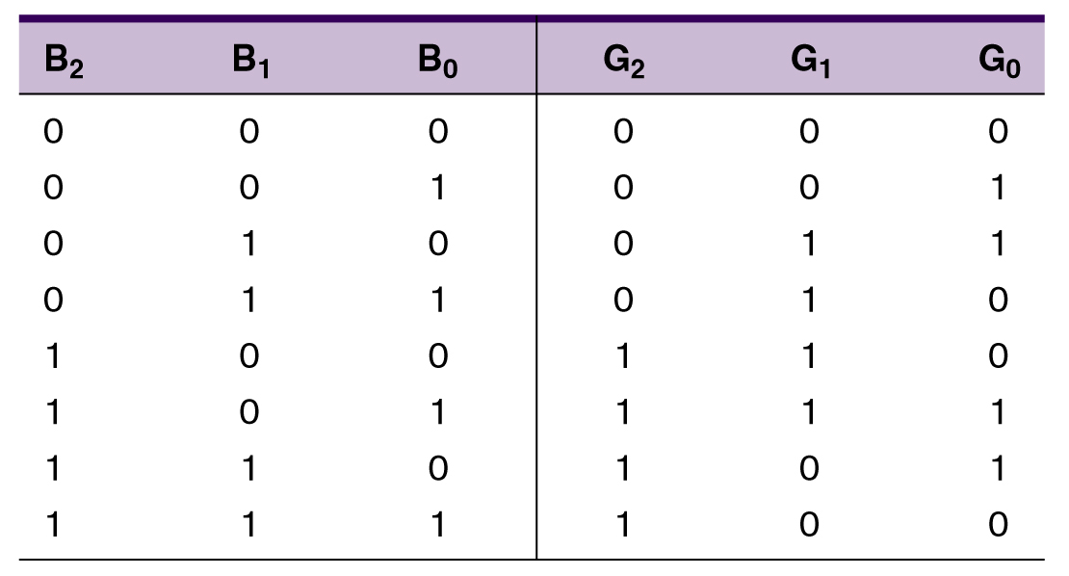
Gray code
The Gray code is used in applications where numbers change rapidly.
Only one bit changes from each value to the next.
This allows to avoid problems in systems where an error can occur if more than one bit changes at a time
Three bit binary and Gray code equivalents.

Slide 53
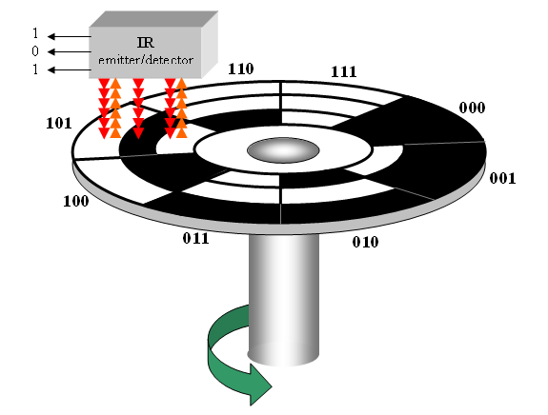
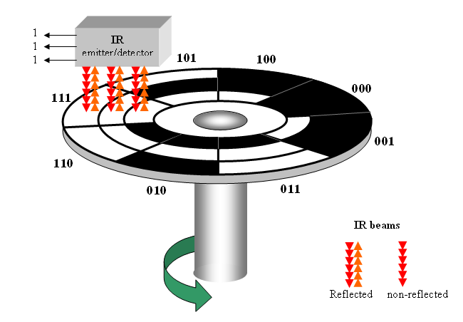
Gray code :
Example of application: A shaft encoder
Three IR emitter/detectors are used to encode the position of the shaft.
The encoder on the left uses binary and can have three bits change together, creating a potential error.
The encoder on the right uses gray code and only 1-bit changes, eliminating potential errors.
Binary sequence
Gray code sequence

Slide 54
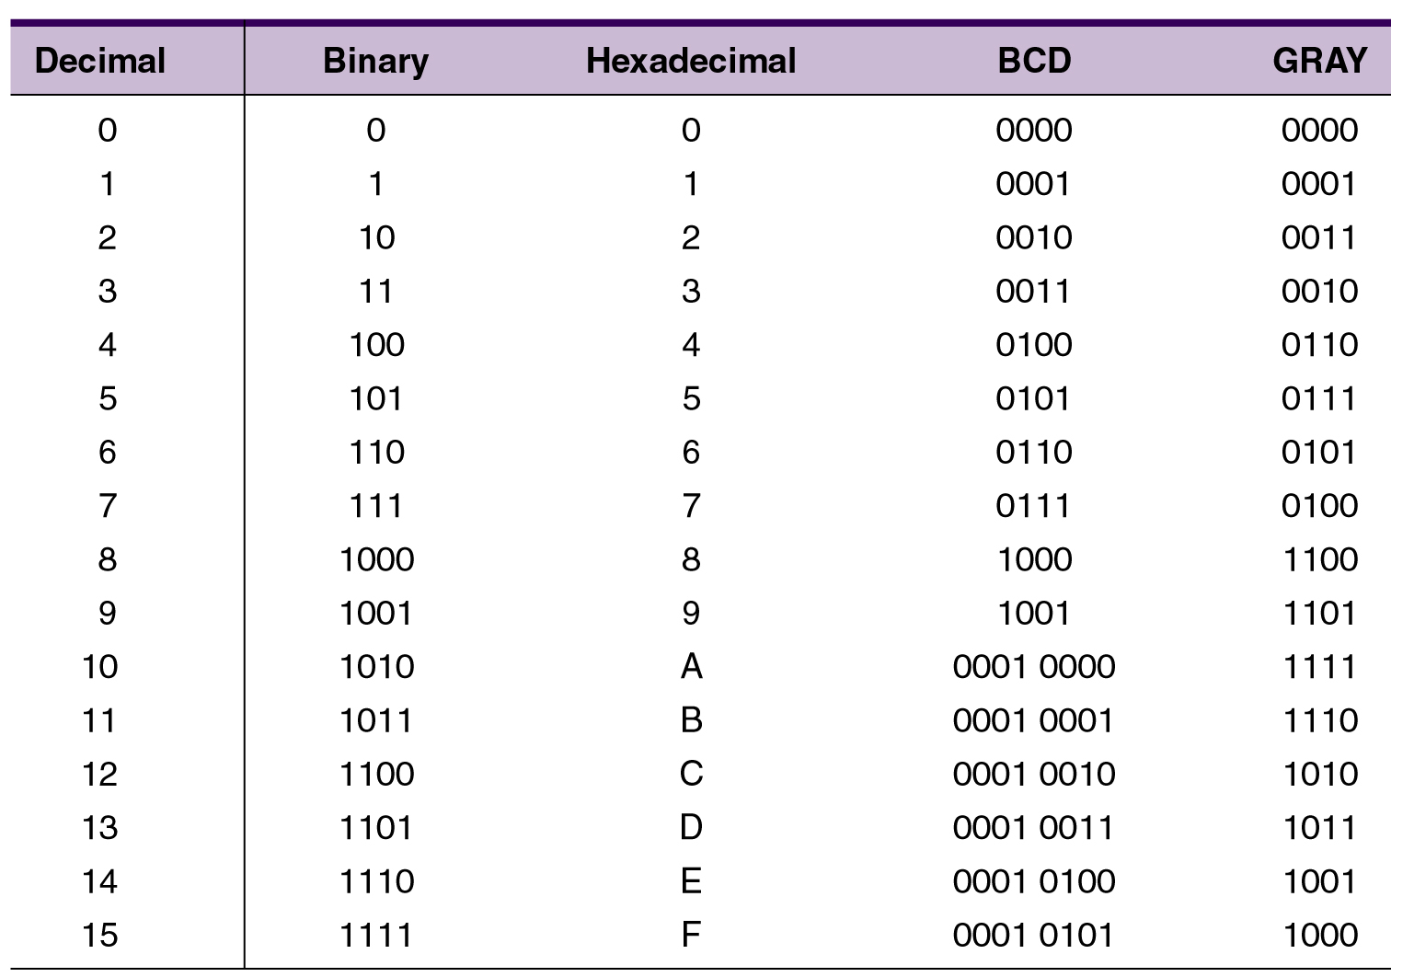
Decimal-Binary-Hex-BCD-Gray
Copyright ©2007 by Pearson Education, Inc. Columbus, OH 43235 All rights reserved.

Slide 55
ASCII (American Standard Code for Information Interchange)
The ASCII code represents characters and functions on a computer keyboard
26 lowercase
26 uppercase letters
10 digits
7 punctuation marks
20 to 40 other characters.
Seven bit code: 2⁷ = 128 possible codes
use: transfer information between computers; computers & printers;
Extension: In 1981, IBM introduced extended ASCII, which is an 8-bit code and increased the character set to 256
Copyright ©2007 by Pearson Education, Inc. Columbus, OH 43235 All rights reserved.

Slide 56
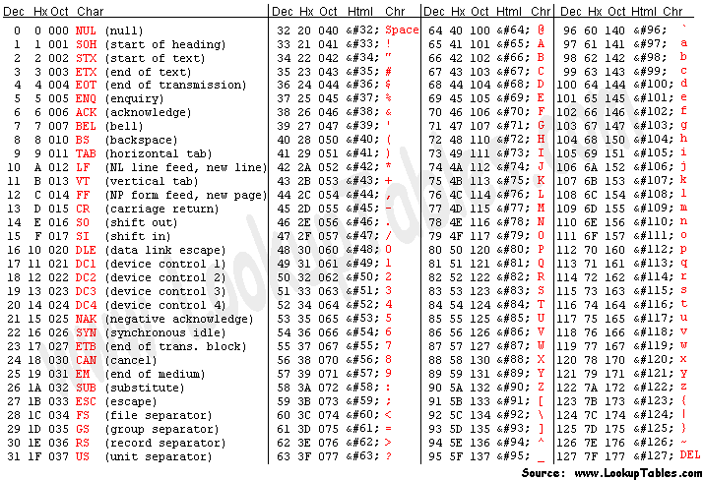
ASCII code

Slide 57
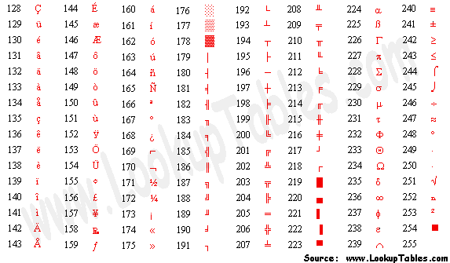
ASCII code

Slide 58
UNICODE
UNICODE extends ASCII to 65,536 universal characters codes
For encoding characters in world languages
Available in many modern applications
2 byte (16-bit) code words

Slide 59
Conversion or Coding?
Do NOT mix up "conversion of a decimal number to a binary number" with "coding a decimal number with a binary code".
13₁₀ = 1101₂
This is conversion
13 ⇔ 0001 0011_{BCD}
This is coding

